Slide 1
Some applications of parallel computing in fluid mechanics
Sreevatsa Anantharamu
Post-doctoral Associate
Aerospace Engineering and Mechanics

Slide 2
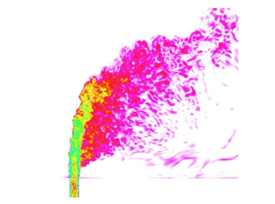
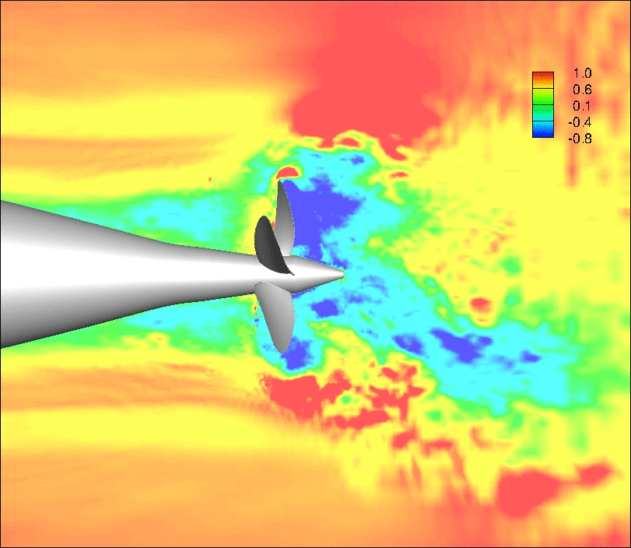
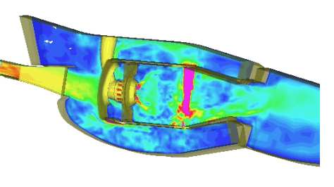
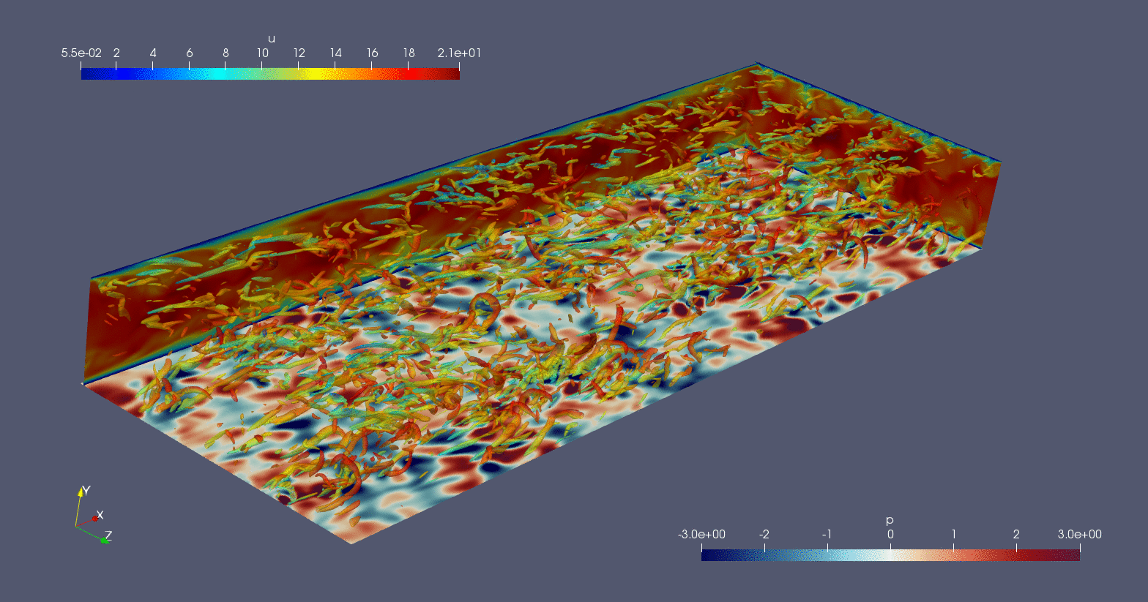
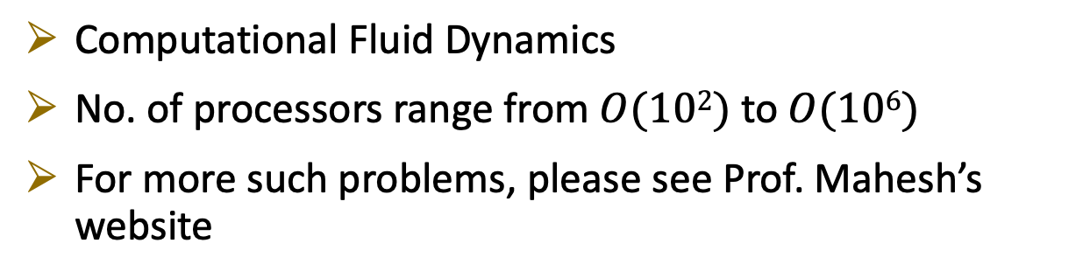
Example fluid mechanics problems that require parallel computers
Jet in crossflow:
Iyer and Mahesh, JFM, 2016, 790
Gas turbine combustor:
Mahesh, Constantinescu and Moin, JCP, 2004, 197
Propeller crashback:
Verma, Jang & Mahesh, JFM, 2012, 704
Computational Fluid Dynamics
No. of processors range from $O(102)$to $O(106)$
For more such problems, please see Prof. Mahesh’s website
Turbulent flow between parallel plates:
Anantharamu and Mahesh, JFM, 2020, 898
https://dept.aem.umn.edu/people/faculty/kmahesh/index.html

Slide 3
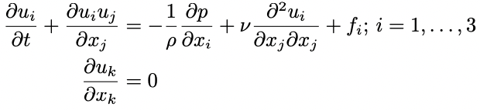
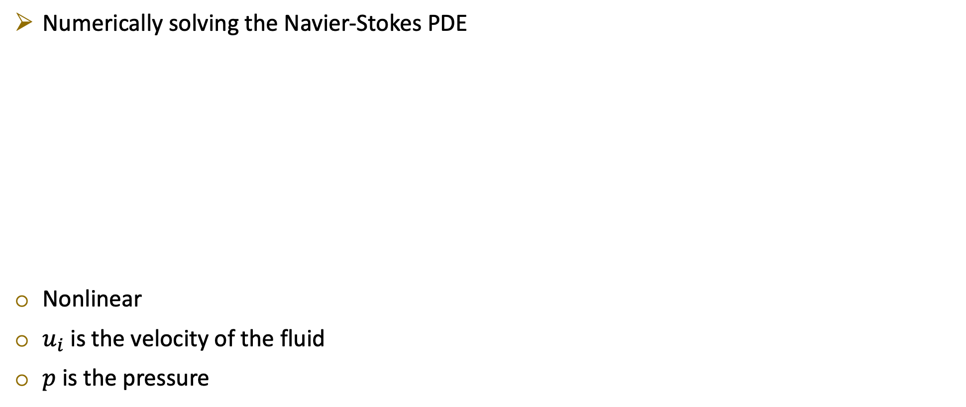
How to simulate these (low-speed) fluid flows?
Numerically solving the Navier-Stokes PDE
Nonlinear
$u_{i}$ is the velocity of the fluid
$p$ is the pressure

Slide 4
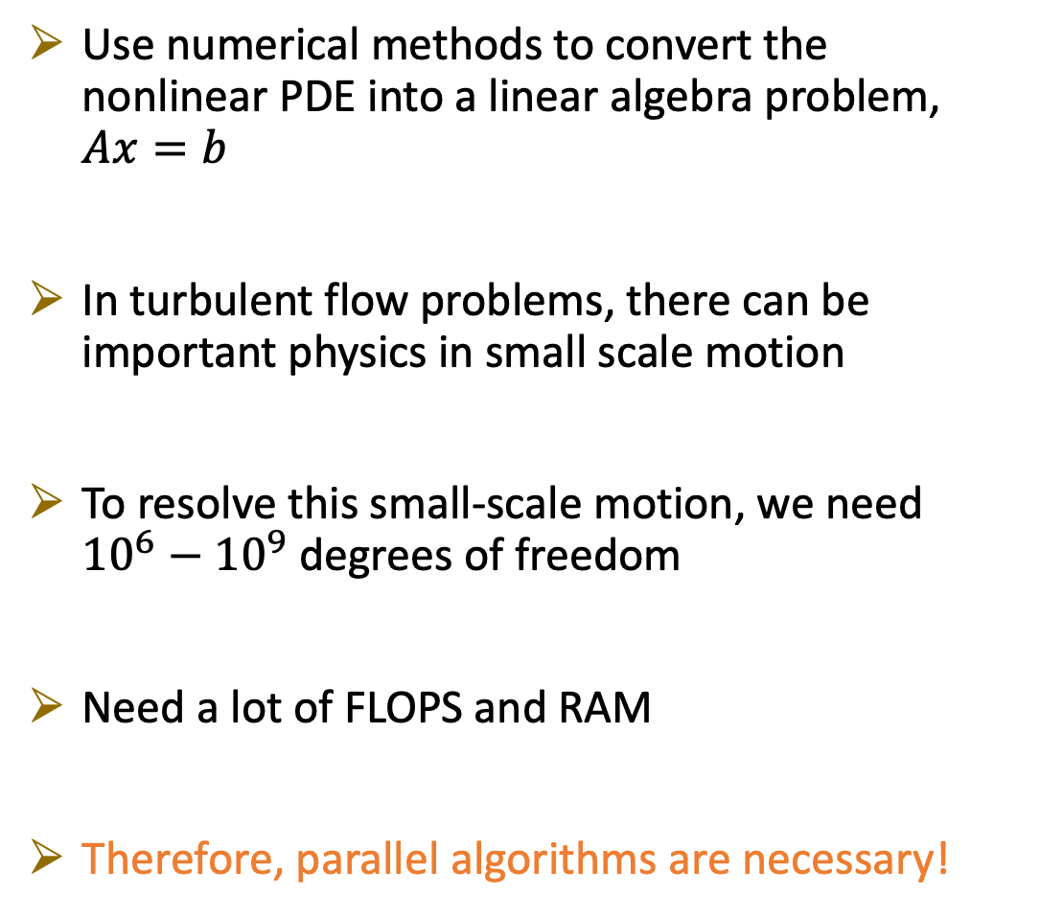
Why are parallel algorithms necessary?
Use numerical methods to convert the nonlinear PDE into a linear algebra problem, $Ax=b$
In turbulent flow problems, there can be important physics in small scale motion
To resolve this small-scale motion, we need ${10}^{6}−{10}^{9}$ degrees of freedom
Need a lot of FLOPS and RAM
Therefore, parallel algorithms are necessary!
This is a simple-looking problem but the total number of degrees of freedom is around a billion!

Slide 5
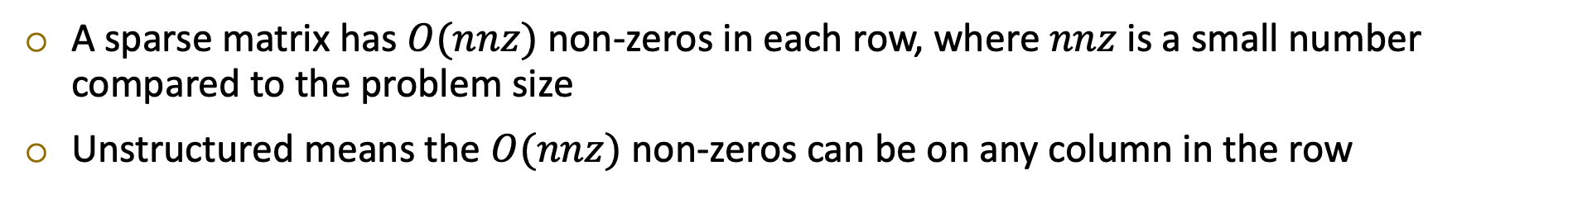
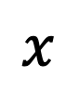
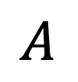
Topic of this lecture
In this lecture, I will discuss parallel algorithm for a crucial operation that arises in these simulations
The parallel unstructured sparse matrix-vector multiplication
$$A$$
$$x$$
A sparse matrix has $O(nnz)$ non-zeros in each row, where $nnz$ is a small number compared to the problem size
Unstructured means the $O(nnz)$ non-zeros can be on any column in the row

Slide 6
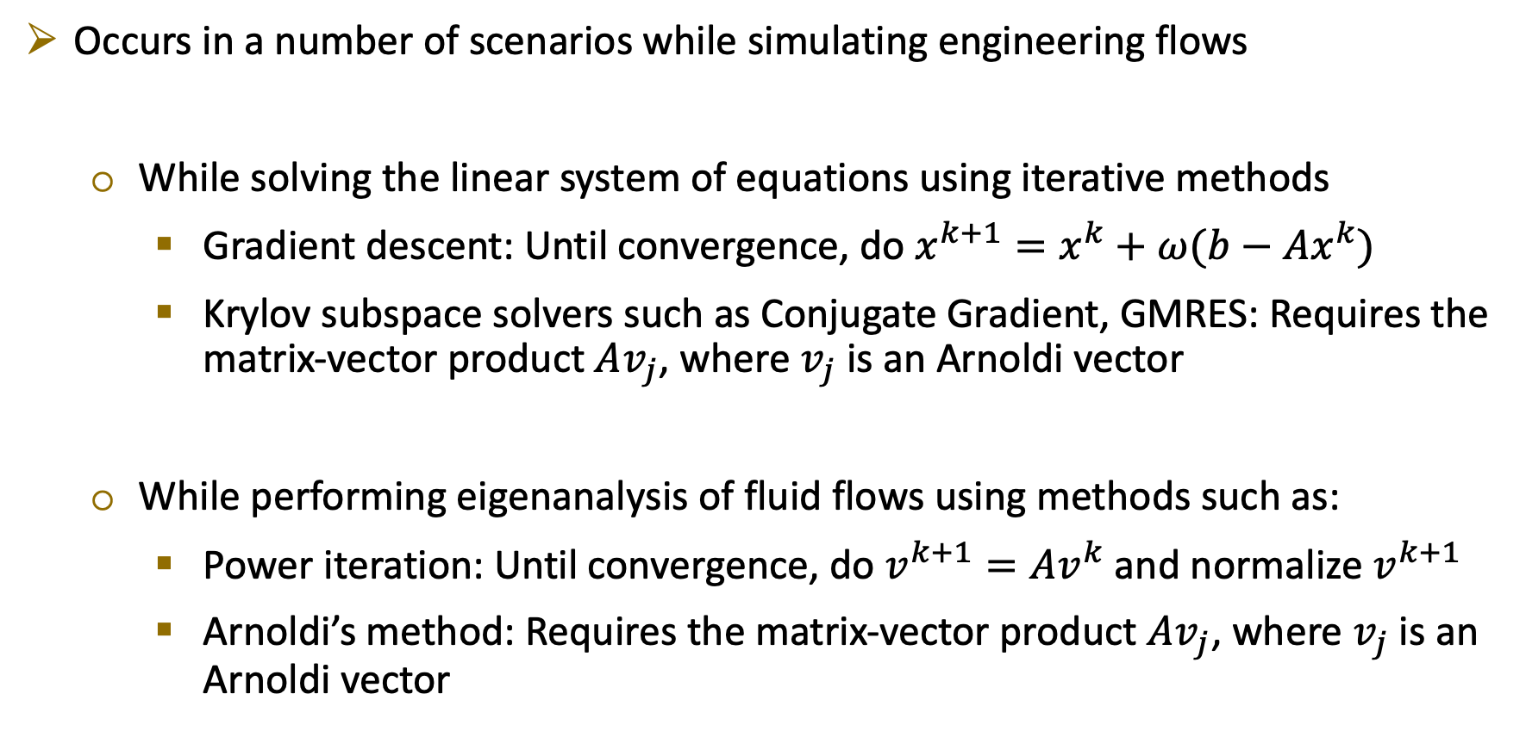
Why is unstructured parallel sparse matrix-vector multiplication crucial?
Occurs in a number of scenarios while simulating engineering flows
While solving the linear system of equations using iterative methods
Gradient descent: Until convergence, do $x^{k+1}=x^{k}+ω(b−Ax^{k})$
Krylov subspace solvers such as Conjugate Gradient, GMRES: Requires the matrix-vector product $Av_{j}$, where $v_{j}$ is an Arnoldi vector
While performing eigenanalysis of fluid flows using methods such as:
Power iteration: Until convergence, do $v^{k+1}=Av^{k}$ and normalize $v^{k+1}$
Arnoldi’s method: Requires the matrix-vector product $Av_{j}$, where $v_{j}$ is an Arnoldi vector

Slide 7
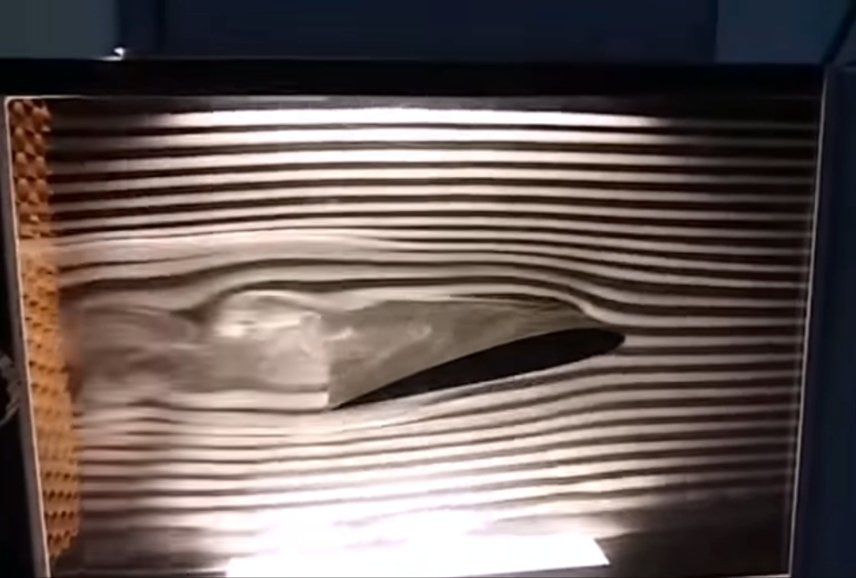
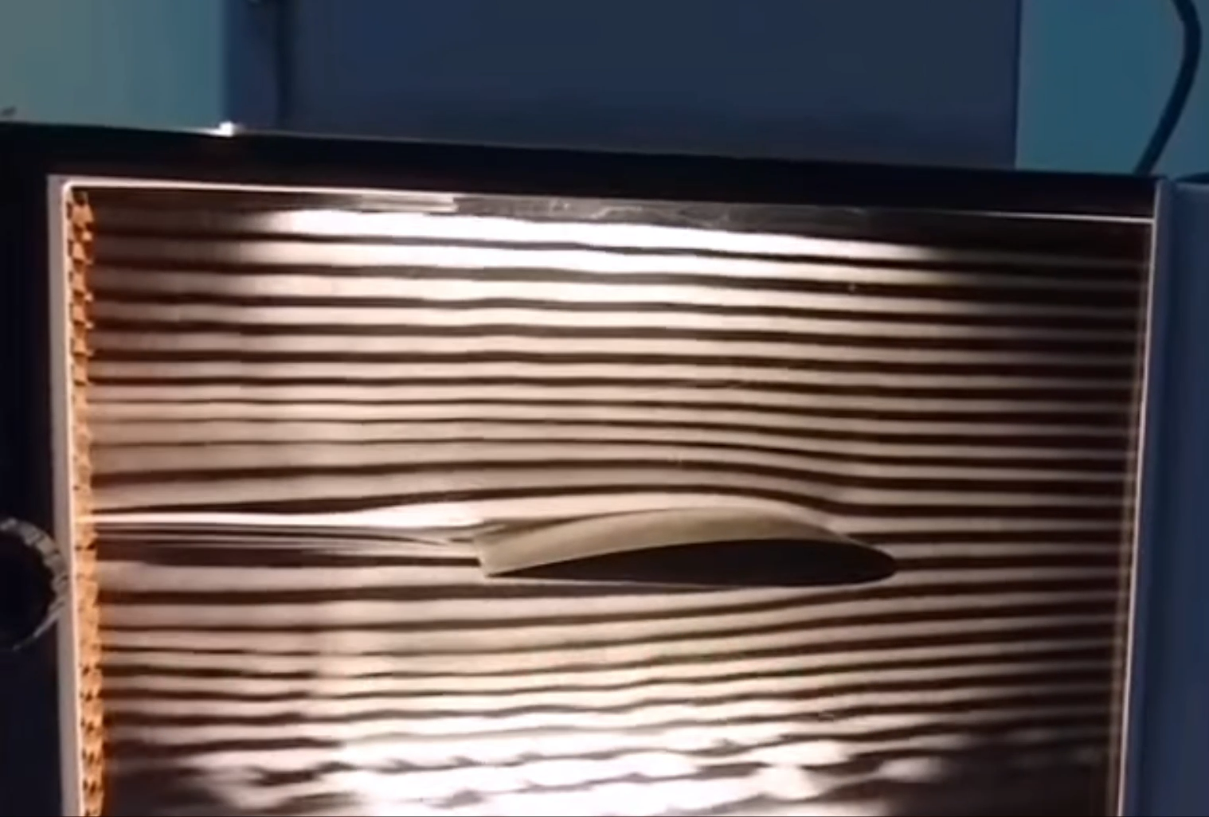
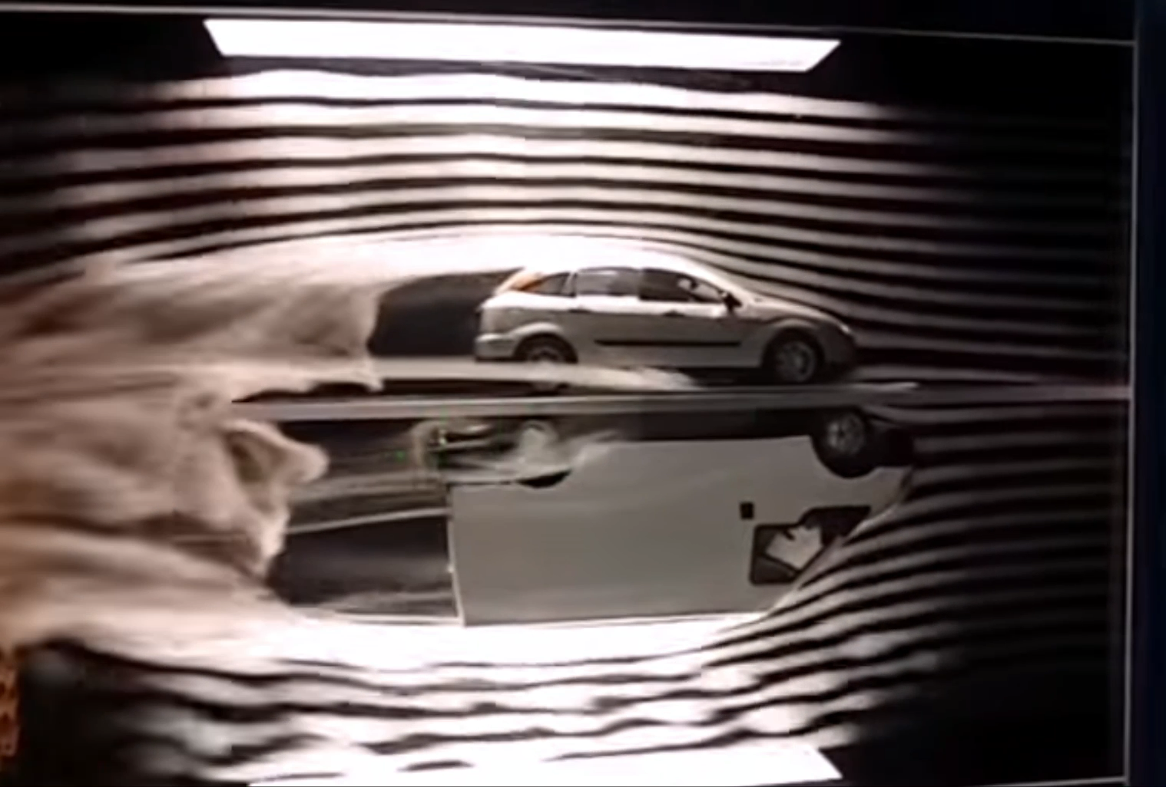
The simplest fluid mechanics problem that leads to an unstructured sparse matrix-vector multiplication
Transport of a dye (for e.g., smoke) in a flow
How can we simulate the concentration of a dye in a flow?
Flow over an airplane wing during take off and landing
Flow over an airplane wing during cruise
Flow over a car and a truck
https://www.youtube.com/watch?v=_q6ozALzkF4

Slide 8
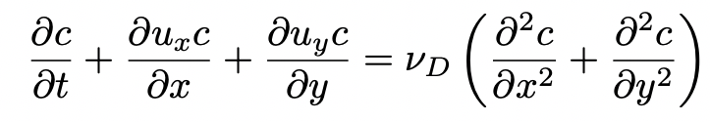
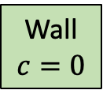
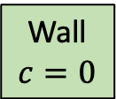
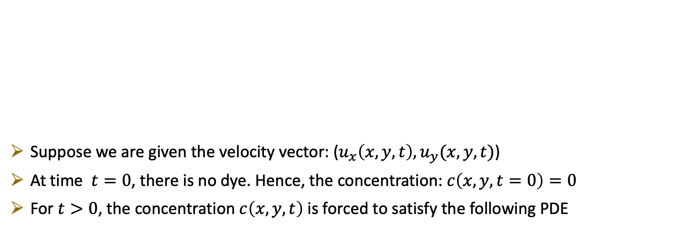
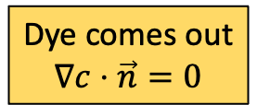
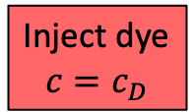
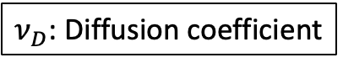
Problem setup
Wall
$$c=0$$
A general computational domain
Suppose we are given the velocity vector: ($u_{x}\left(x,y,t\right), u_{y}(x,y,t)$)
At time $t=0$, there is no dye. Hence, the concentration: $c\left(x,y,t=0\right)=0$
For$t>0$, the concentration $c\left(x,y,t\right)$ is forced to satisfy the following PDE
Inject dye
$$c=c_{D}$$
Wall
$$c=0$$
Dye comes out
$$∇c⋅\vec{n}=0$$
$ν_{D}$: Diffusion coefficient
and the boundary conditions shown in the above figure

Slide 9
How to numerically solve this PDE?
12
11
24
5
1
16
13
9
21
2
3
22
4
14
23
10
8
6
7
17
19
20
15
18
Divide the domain into elements
The set of elements is called a ‘mesh’ (also called a ‘grid’)
In the example mesh shown, the elements are triangles, and there are 24 of them

Slide 10
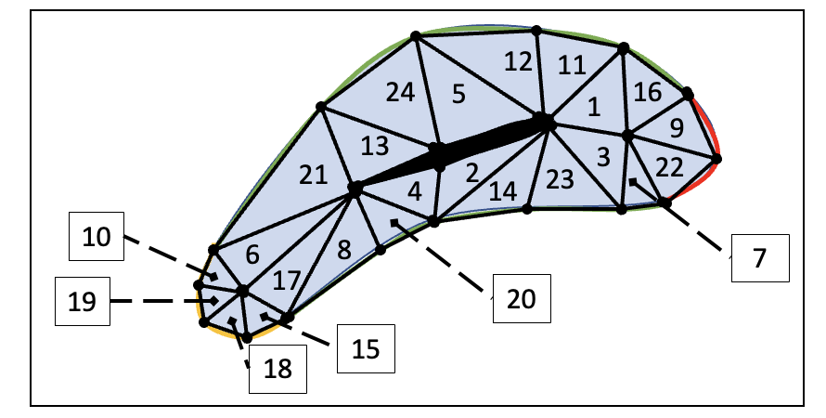
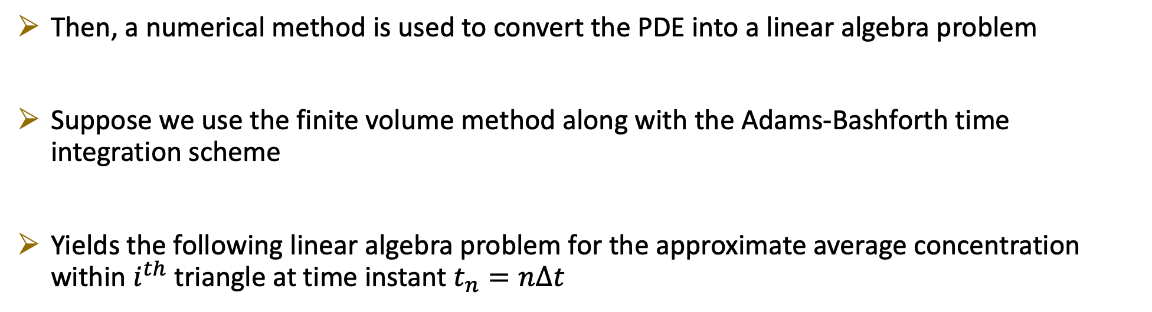
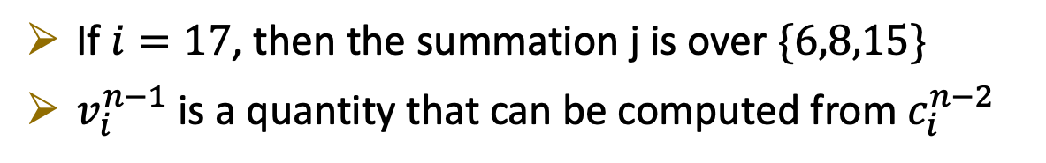
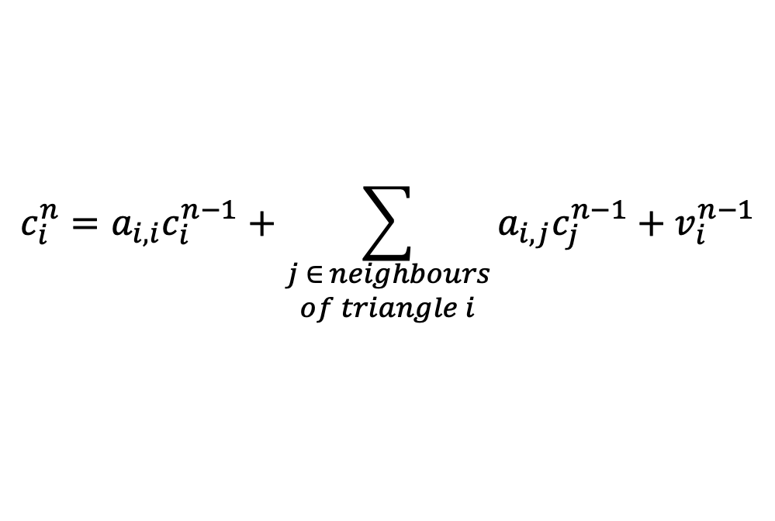
How to numerically solve this PDE?
Then, a numerical method is used to convert the PDE into a linear algebra problem
Suppose we use the finite volume method along with the Adams-Bashforth time integration scheme
Yields the following linear algebra problem for the approximate average concentration within $i^{th}$ triangle at time instant $t_{n}=nΔt$
$$c_{i}^{n}=a_{i,i}c_{i}^{n−1}+\sum_{\begin{aligned}j ∈ neighbours \\ of triangle i\end{aligned}}{a_{i,j}c_{j}^{n−1}}+v_{i}^{n−1}$$
If $i=17$, then the summation j is over $\{6,8,15\}$
$v_{i}^{n−1}$ is a quantity that can be computed from $c_{i}^{n−2}$

Slide 11
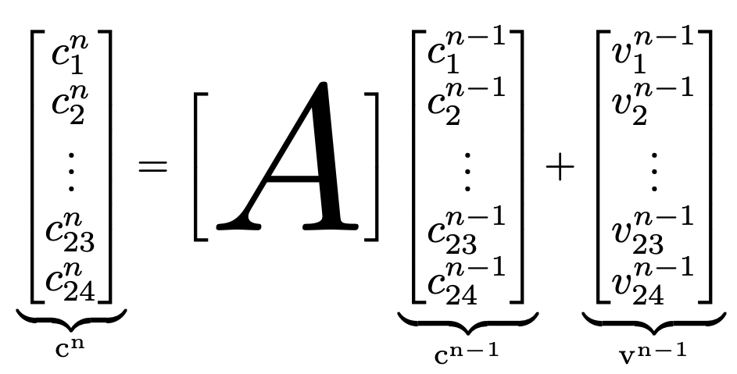
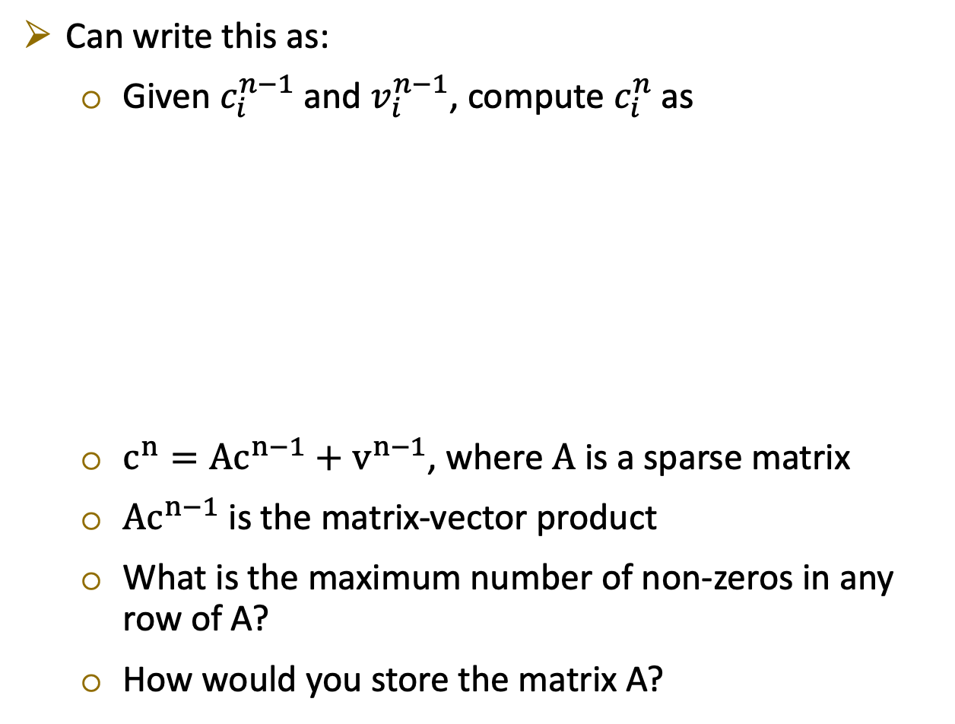
How to numerically solve this PDE?
Can write this as:
Given $c_{i}^{n−1}$ and $v_{i}^{n−1}$, compute $c_{i}^{n}$ as
$c^{n}=Ac^{n−1}+v^{n−1}$, where $A$ is a sparse matrix
$Ac^{n−1}$ is the matrix-vector product
What is the maximum number of non-zeros in any row of A?
How would you store the matrix A?
Mesh
Sparsity pattern of A

Slide 12
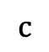
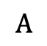
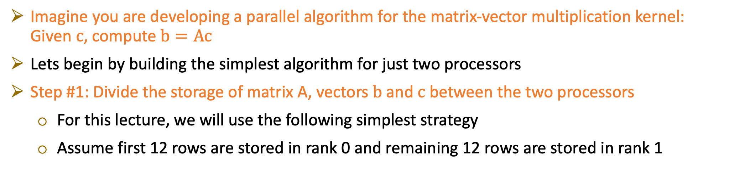
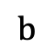
How can we perform this matrix-vector multiplication in parallel?
Imagine you are developing a parallel algorithm for the matrix-vector multiplication kernel: Given $c$, compute $b=Ac$
Lets begin by building the simplest algorithm for just two processors
Step #1: Divide the storage of matrix A, vectors $b$ and $c$ between the two processors
For this lecture, we will use the following simplest strategy
Assume first 12 rows are stored in rank 0 and remaining 12 rows are stored in rank 1
rank 0
=
rank 1
$$b$$
$$A$$
$$c$$

Slide 13
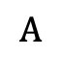
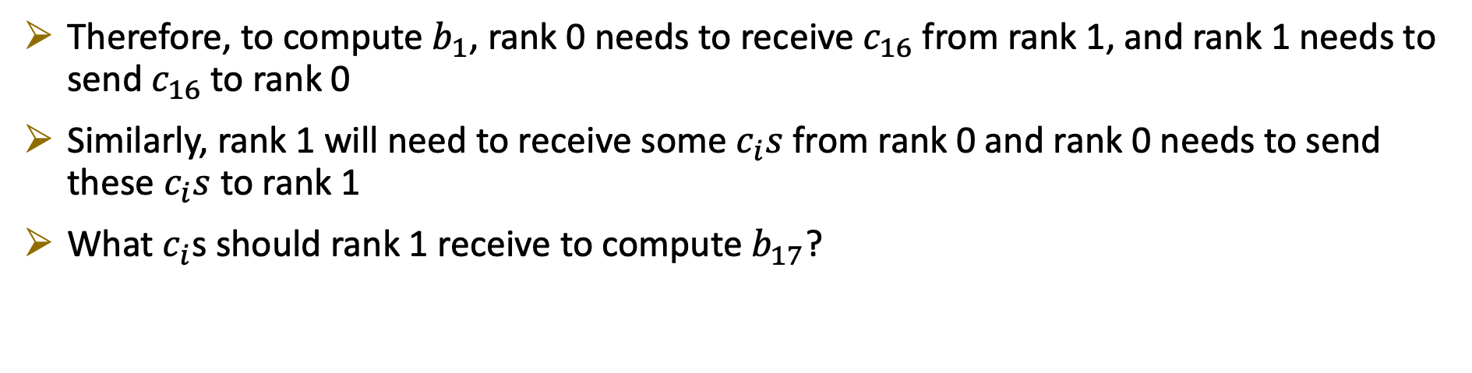
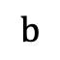
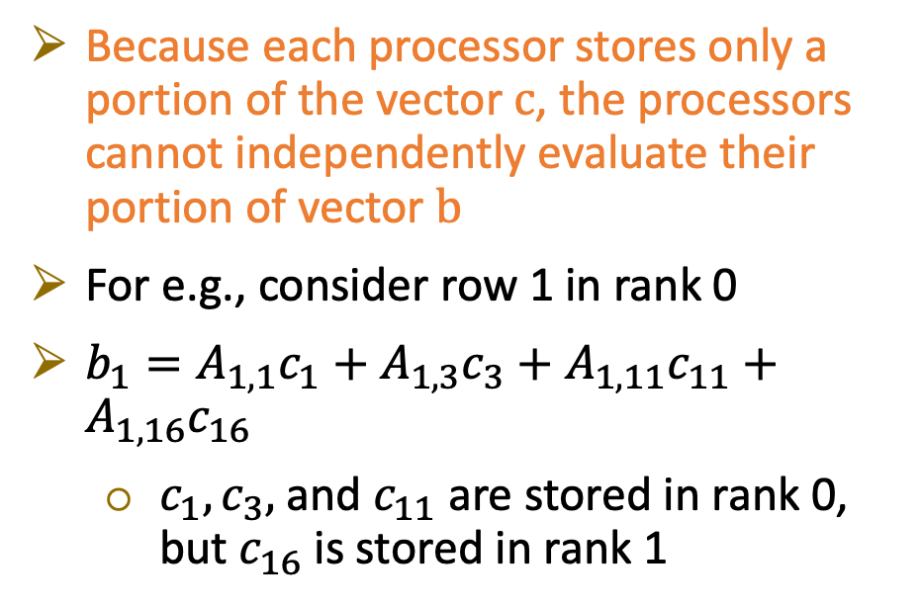
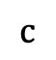
A problem
Because each processor stores only a portion of the vector $c$, the processors cannot independently evaluate their portion of vector $b$
For e.g., consider row 1 in rank 0
$b_{1}=A_{1,1}c_{1}+A_{1,3}c_{3}+A_{1,11}c_{11}+A_{1,16}c_{16}$
$c_{1},c_{3},$and $c_{11}$ are stored in rank 0, but $c_{16}$ is stored in rank 1
rank 0
=
rank 1
$$b$$
$$A$$
$$c$$
Therefore, to compute $b_{1}$, rank 0 needs to receive $c_{16}$ from rank 1, and rank 1 needs to send $c_{16}$ to rank 0
Similarly, rank 1 will need to receive some $c_{i}s$ from rank 0 and rank 0 needs to send these $c_{i}s$ to rank 1
What $c_{i}$s should rank 1 receive to compute $b_{17}$?

Slide 14
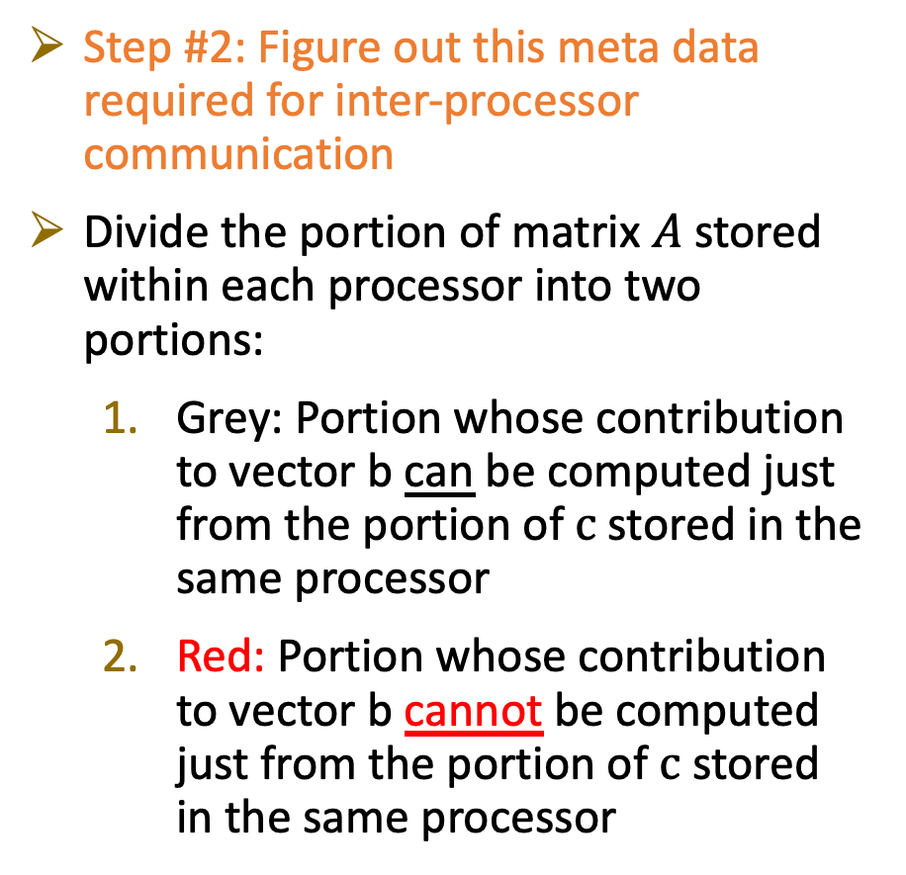
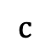
Parallel sparse matrix-vector multiplication
Step #2: Figure out this meta data required for inter-processor communication
Divide the portion of matrix $A$ stored within each processor into two portions:
Grey: Portion whose contribution to vector b can be computed just from the portion of $c$ stored in the same processor
Red: Portion whose contribution to vector b cannot be computed just from the portion of $c$ stored in the same processor
rank 0
=
rank 1
$$b$$
$$A$$
$$c$$
$$b_{1}=A_{1,1}c_{1}+A_{1,3}c_{3}+A_{1,11}c_{11}+A_{1,16}c_{16}$$

Slide 15
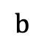
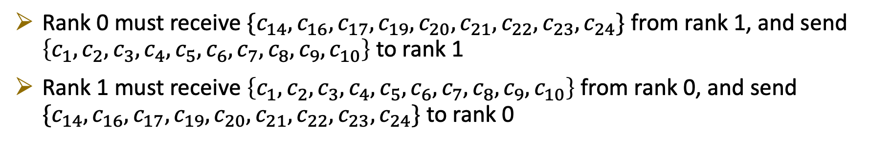
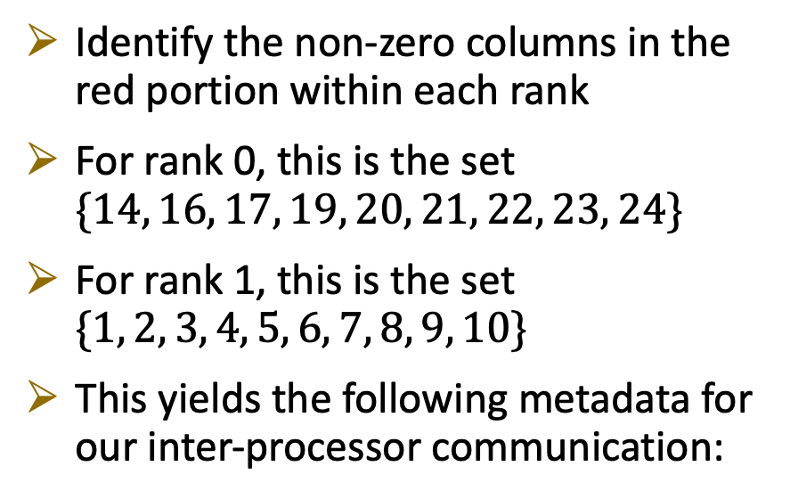
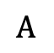
Parallel sparse matrix-vector multiplication
Identify the non-zero columns in the red portion within each rank
For rank 0, this is the set $\{14, 16, 17, 19, 20, 21, 22, 23, 24\}$
For rank 1, this is the set $\{1, 2, 3, 4, 5, 6, 7, 8, 9, 10\}$
This yields the following metadata for our inter-processor communication:
rank 0
=
rank 1
$$b$$
$$A$$
$$c$$
Rank 0 must receive $\{c_{14}, c_{16}, c_{17}, c_{19}, c_{20}, c_{21}, c_{22}, c_{23}, c_{24}\}$ from rank 1, and send $\left\{c_{1}, c_{2}, c_{3}, c_{4}, c_{5}, c_{6}, c_{7}, c_{8}, c_{9}, c_{10}\right\}$ to rank 1
Rank 1 must receive $\left\{c_{1}, c_{2}, c_{3}, c_{4}, c_{5}, c_{6}, c_{7}, c_{8}, c_{9}, c_{10}\right\}$ from rank 0, and send $\{c_{14}, c_{16}, c_{17}, c_{19}, c_{20}, c_{21}, c_{22}, c_{23}, c_{24}\}$ to rank 0

Slide 16
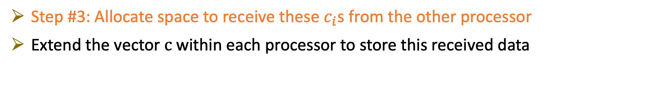
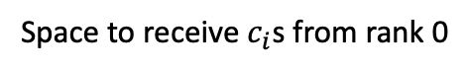
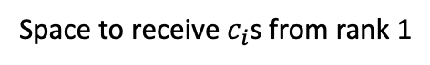
Parallel sparse matrix-vector multiplication
Step #3: Allocate space to receive these $c_{i}$s from the other processor
Extend the vector $c$ within each processor to store this received data
rank 0
$$c_{1}$$ | $$c_{2}$$ | $$c_{3}$$ | $$c_{4}$$ | $$c_{5}$$ | $$c_{6}$$ | $$c_{7}$$ | $$c_{8}$$ | $$c_{9}$$ | $$c_{10}$$ | $$c_{11}$$ | $$c_{12}$$ | $$c_{14}$$ | $$c_{16}$$ | $$c_{17}$$ | $$c_{19}$$ | $$c_{20}$$ | $$c_{21}$$ | $$c_{22}$$ | $$c_{23}$$ | $$c_{24}$$
Portion stored in rank 0
Space to receive $c_{i}$s from rank 1
rank 1
$$c_{13}$$ | $$c_{14}$$ | $$c_{15}$$ | $$c_{16}$$ | $$c_{17}$$ | $$c_{18}$$ | $$c_{19}$$ | $$c_{20}$$ | $$c_{21}$$ | $$c_{22}$$ | $$c_{23}$$ | $$c_{24}$$ | $$c_{1}$$ | $$c_{2}$$ | $$c_{3}$$ | $$c_{4}$$ | $$c_{5}$$ | $$c_{6}$$ | $$c_{7}$$ | $$c_{8}$$ | $$c_{9}$$ | $$c_{10}$$
Portion stored in rank 1
Space to receive $c_{i}$s from rank 0

Slide 17
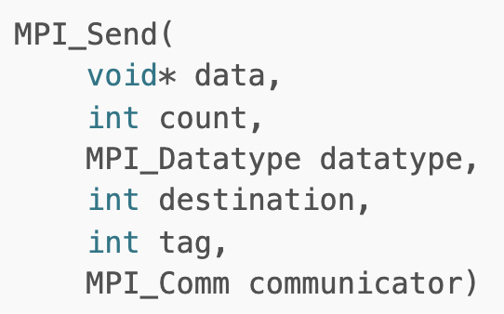
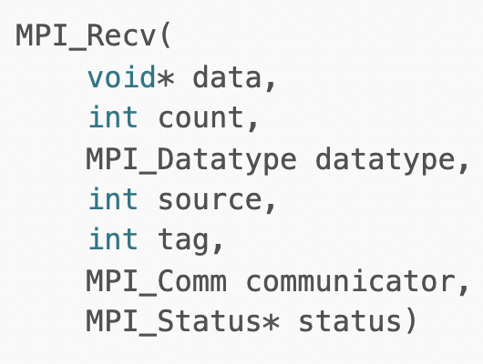
Parallel sparse matrix-vector multiplication
Step #4: Perform the inter-processor communication
We will use the simplest MPI point-to-point communication routines MPI_SEND and MPI_RECV
These are blocking communication routines
Blocking means that the program will not proceed further until the communication is finished
Fortran code

Slide 18
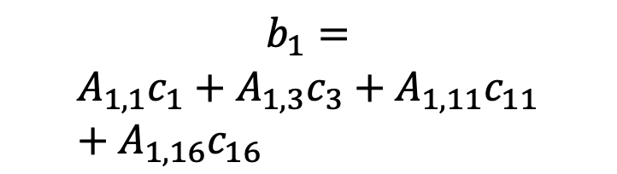
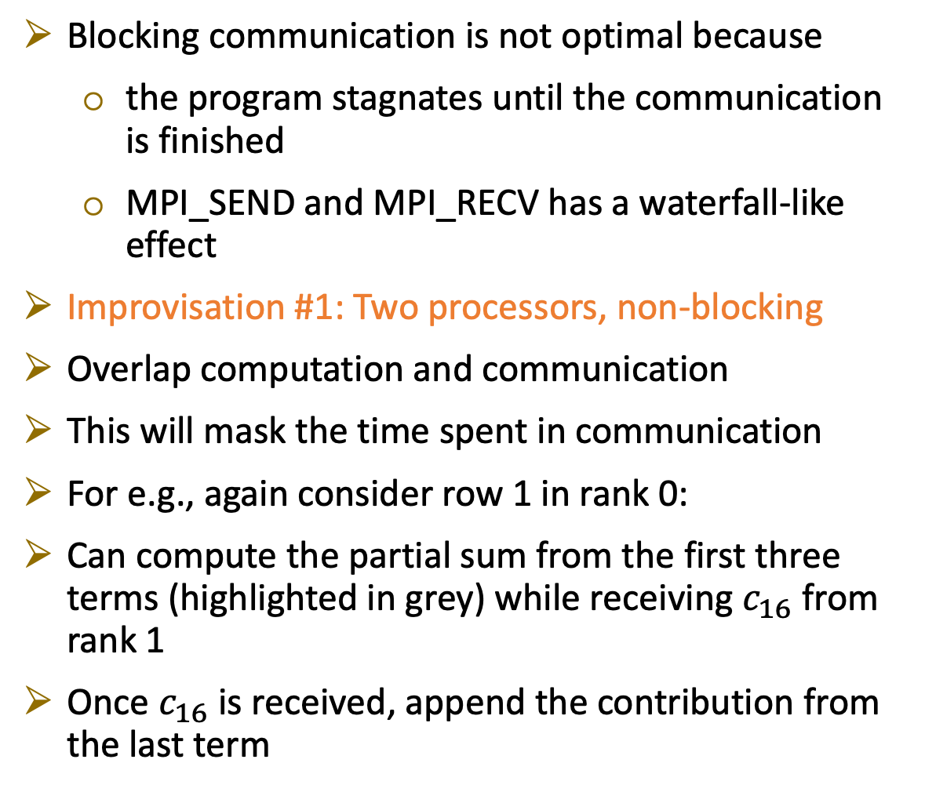
Parallel sparse matrix-vector multiplication
Blocking communication is not optimal because
the program stagnates until the communication is finished
MPI_SEND and MPI_RECV has a waterfall-like effect
Improvisation #1: Two processors, non-blocking
Overlap computation and communication
This will mask the time spent in communication
For e.g., again consider row 1 in rank 0:
Can compute the partial sum from the first three terms (highlighted in grey) while receiving $c_{16}$ from rank 1
Once $c_{16}$ is received, append the contribution from the last term
$$b_{1}=$$
$$A_{1,1}c_{1}+A_{1,3}c_{3}+A_{1,11}c_{11}+A_{1,16}c_{16}$$

Slide 19


Parallel sparse matrix-vector multiplication
Pseudo code:
Begin communication
Compute the contribution from the grey portion of the matrix A
Finish communication
Compute the contribution from the red portion of the matrix A
To perform non-blocking send and receive use MPI_Isend/Irecv
Fortran code

Slide 20
Parallel sparse matrix-vector multiplication
Improvisation #2: Large number of processors and rows, blocking/non-blocking
Say, 1 billion rows and 0.1 million processors!
How to extend the above ideas in a scalable manner?

Slide 21


Parallel sparse matrix-vector multiplication
Two major issues:
Linear decomposition of rows may not be optimal
By optimal, we mean least amount of data exchanged between processors
Need graph partitioning
Third Party Libraries: METIS, ParMETIS, Zoltan, SCOTCH, Mongoose
E.g.: 1.3 billion rows divided into 0.14 million processors using ParMETIS
Need a (cost and memory) scalable algorithm to ascertain the metadata necessary for inter-processor communication
Complicated, but possible!
Computational domain for flow around a submarine hull
Slice of the above figure along the axis of the cylinder
Submarine hull

Slide 22
Some supercomputers used by my current research group
Supercomputer | Number of processors
Mira (ANL) | 0.78 million
Stampede2 (XSEDE) | 0.29 million
Narwhal (DOE) | 0.29 million
Onyx (DOE) | 0.12 million
Centennial (DOE) | 72 thousand
Mustang (DOE) | 56 thousand
Mangi (MSI) | 20 thousand
Mesabi (MSI) | 18 thousand

